Slide 1

Scalable

Slide 2
Introduction
to Scaling Networks
Scaling Networks

Slide 3
Scaling Networks
Introduction
Implementing a Network Design
Selecting Network Devices
Summary

Slide 4
Objectives
▪ Describe the use of a hierarchical network for a small business.
▪ Describe recommendations for designing a network that is scalable.
▪ Describe the type of switches available for small-to-medium-sized
business networks.
▪ Describe the type of routers available for small-to-medium-sized
business networks.
▪ Configure and verify basic settings on a Cisco IOS device.

Slide 5
Implementing a
Network Design
Scaling Networks

Slide 6
Hierarchical Network Design
Network Scaling Needs
As they grow and expand, all enterprise networks must:
▪ Support critical applications
▪ Support converged network traffic
▪ Support diverse business needs
▪ Provide centralized administrative control

Slide 7
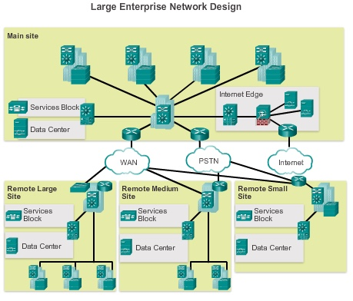
Hierarchical Network Design
Enterprise Business Devices
To provide a high-reliability network, enterprise class equipment is
installed in the enterprise network.

Slide 8
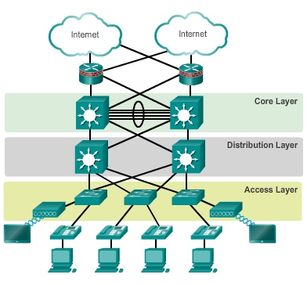
Hierarchical Network Design
Hierarchical Network Design
This model divides the network functionality into three distinct layers.

Slide 9
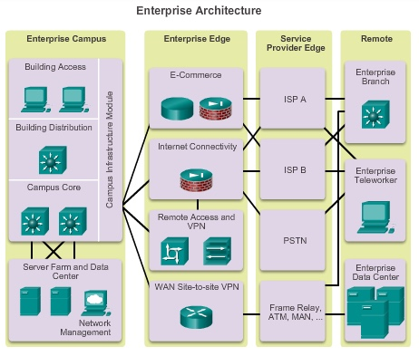
Hierarchical Network Design
Cisco Enterprise Architecture
The primary Cisco
Enterprise Architecture
modules include:
▪ Enterprise Campus
▪ Enterprise Edge
▪ Service Provider Edge
▪ Remote

Slide 10
Hierarchical Network Design
Failure Domains
▪ Failure Domains are areas of a network that are impacted when a
critical device or network service experiences problems.
▪ Redundant links and enterprise class equipment minimize
disruption of network.
▪ Smaller failure domains reduce the impact of a failure on company
productivity.
▪ Smaller failure domains also simplify troubleshooting.
▪ Switch block deployment – each switch block acts independently of
the others. Failure of a single device does not impact the whole
network.

Slide 11
Expanding the Network
Designing for Scalability
▪ Use expandable, modular equipment or clustered devices.
▪ Include design modules that can be added, upgraded, and
modified, without affecting the design of the other functional areas
of the network.
▪ Create a hierarchical addressing scheme.
▪ Use routers or multilayer switches to limit broadcasts and filter
traffic.

Slide 12
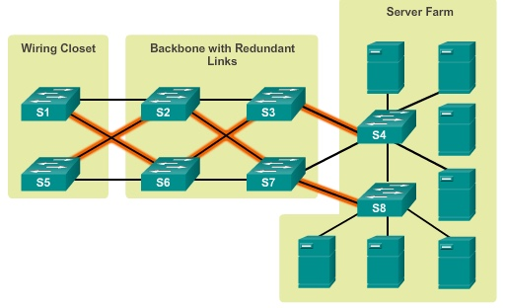
Expanding the Network
Planning for Redundancy
▪ Installing duplicate equipment
▪ Providing redundant paths

Slide 13
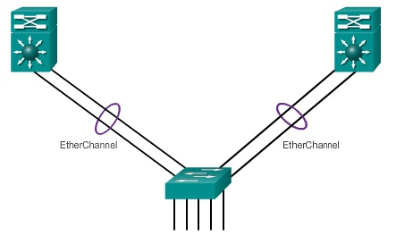
Expanding the Network
Increasing Bandwidth
▪ Link aggregation increases the amount of bandwidth between
devices by creating one logical link made up of several physical
links.
▪ EtherChannel is a form of link aggregation used in switched
networks.

Slide 14
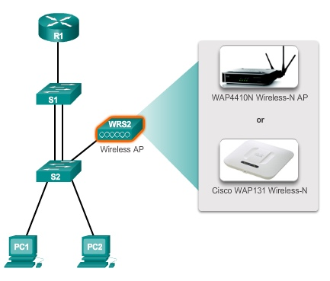
Expanding the Network
Expanding the Access Layer
Access layer connectivity can be extended through wireless
connectivity.

Slide 15
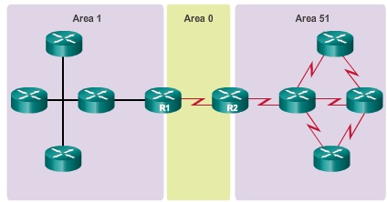
Expanding the Network
Fine-Tuning Routing Protocols
OSPF works well for large, hierarchical networks.

Slide 16
Selecting Network
Devices
Scaling Networks

Slide 17
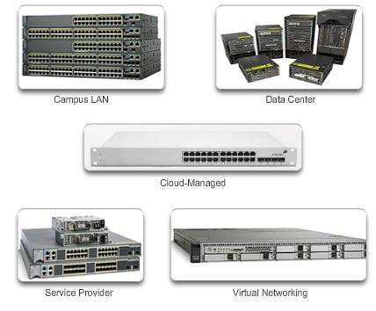
Switch Hardware
Switch Platforms
Select form factor:
▪ Fixed
▪ Modular
▪ Stackable
▪ Non-stackable

Slide 18
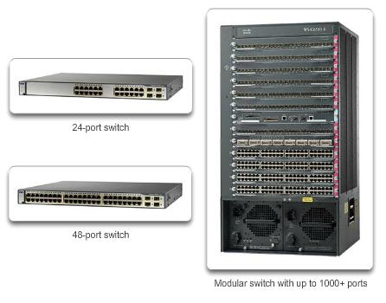
Switch Hardware
Port Density

Slide 19
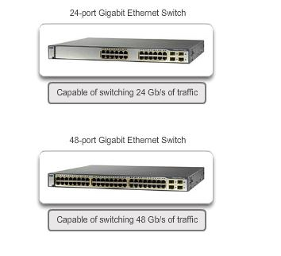
Switch Hardware
Forwarding Rates
The processing capabilities of a switch are rated by how much data
the switch can process per second.

Slide 20
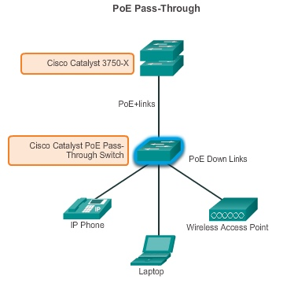
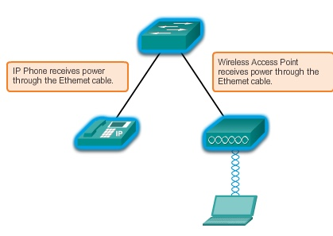
Switch Hardware
Power over Ethernet

Slide 21
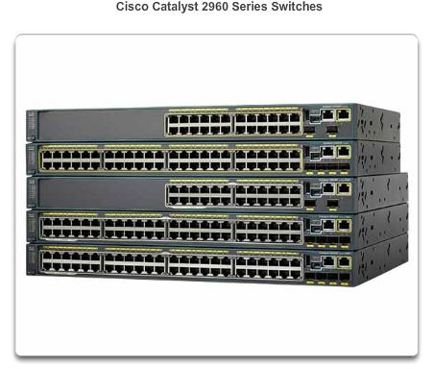
Switch Hardware
Multilayer Switching
▪ Deployed in the core and distribution layers of an organization’s
switched network.
▪ Can build a routing table, support a few routing protocols, and
forward IP packets.

Slide 22
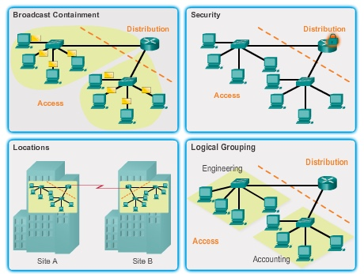
Router Hardware
Router Requirements
Role of routers:
▪ Interconnect multiple sites
▪ Provide redundant paths
▪ Connect ISPs
▪ Translate between media
types and protocols

Slide 23
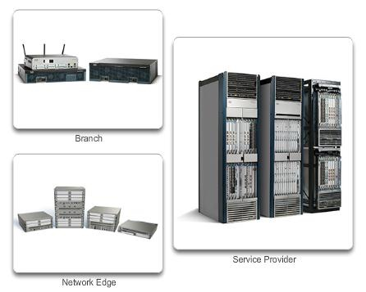
Router Hardware
Cisco Routers
Three categories of routers:
▪ Branch – Highly available
24/7.
▪ Network Edge – High
performance, high security,
and reliable services.
Connect campus, data
center, and branch networks.
▪ Service provider routers

Slide 24
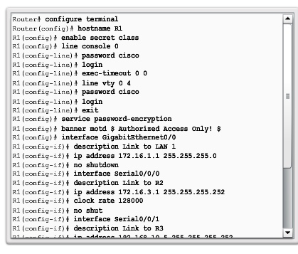
Managing Devices
Basic Router CLI commands
Basic router configuration
includes:
▪ Hostname
▪ Passwords (console,
Telnet/SSH, and privileged
mode)
▪ Interface IP addresses
▪ Enabling a routing protocol

Slide 25
Managing Devices
Basic Router show Commands
▪show ip protocols – Displays information about routing
protocol configured.
▪show ip route – Displays routing table information.
▪show ip ospf neighbor – Displays information about OSPF
neighbors.
▪show ip interfaces – Displays detailed information about
interfaces.
▪show ip interface brief – Displays all interfaces with IP
addressing , interface, and line protocol status.
▪show cdp neighbors – Displays information about all directly
connected Cisco devices.

Slide 26
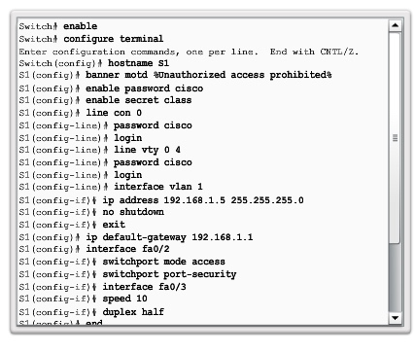
Managing Devices
Basic Switch CLI Commands
▪ Hostname
▪ Passwords
▪ In-Band access requires
the Switch to have an IP
address (assigned to VLAN
1).
▪ Save configuration – copy
running-config
startup-
config command.
▪ To clear switch – erase
startup-config, and
then reload.
▪ To erase VLAN information
– delete
flash:vlan.dat.

Slide 27
Managing Devices
Basic Switch Show Commands
▪show port-security – Displays any ports with security
enabled.
▪show port-security address – Displays all secure MAC
addresses.
▪show interfaces – Displays detailed information about
interfaces.
▪show mac-address-table – Displays all MAC addresses the
switch has learned.
▪show cdp neighbors – Displays all directly connected Cisco
devices.

